Slide 1
Emergency Medical Services for Aliens (EMSA)
Conduent
Government Healthcare Solutions

Slide 2
Overview
To provide an understanding of the EMSA claim process so that services can be billed correctly and claim denials or Return To Providers (RTP) can be avoided.

Slide 3
Objectives
We will review the following:
Overview of EMSA- Category of Eligibility (COE) 085
EMSA Definition and Covered Services
EMSA Application Process
  EMSA Claim Submissions
  Eligibility Verification via NM Web Portal
  EMSA Determinations
  EMSA FAQs
  EMSA Reminders, Tips, and Resources

Slide 4
EMSA Eligibility – COE 085
Conduent
Government Healthcare Solutions

Slide 5
EMSA General Eligibility Policy
The NM Medicaid program provides coverage of EMSA for certain non-citizens who are undocumented or who do not meet the qualifying immigration criteria specified in NMAC 8.200.410. The following requirements must be met:
  The individual must apply for coverage no later than the last day of the third month following the month in which the emergency services were received.
    Example: If the date of service of the emergency service was in January, the client must apply for EMSA coverage by the last day of April.
  Applicant must be a resident of New Mexico.
  Applicant must meet financial eligibility.
  Emergency medical services must meet the definition of emergency per NMAC 8.325.10.13.
    Determination of emergency status is made by the Third Party Assessor (TPA).

Slide 6
EMSA Definition
  Emergency as defined for EMSA includes labor and delivery including inductions and cesarean sections, as well as any other medical conditions, manifesting itself with acute symptoms of sufficient severity such that the absence of immediate emergency medical attention could reasonably be expected to result in one of the following:
  Recipient’s death
  Conditions which place the individual’s health in serious jeopardy
  Serious impairment of bodily functions; or
  Serious dysfunction of any bodily organ or part
  Note: Services are covered only when necessary to treat or evaluate a condition meeting the definition of emergency and are covered only for the duration of that emergency.
Notes:
*Speaker Note*
The 1st emergency room encounter for dialysis will be covered in this instance. Any visits after this will not be covered under EMSA

Slide 7
Services Not Covered Under EMSA
Long Term Care
Organ transplants
Rehabilitation services
Surgical procedures, other than unscheduled emergency procedures
Psychiatric or psychological services
Durable medical equipment or supplies
Eyeglasses
Hearing aids
Outpatient prescriptions
Podiatry services
Prenatal care
Well child care
Routine dental care
Routine dialysis services
Any medical service furnished by a border or out-of-state provider
Non-emergency transportation
Preventive care
Out-of-state medical services are limited to deliveries only when provided by an out of state border provider. The EMSA client must be a resident of New Mexico. The border provider must be an enrolled Medicaid provider.
If an individual’s medical condition requires a transfer to another acute care hospital, the individual must be transferred to an in-state acute care hospital.

Slide 8
Prior Authorizations (PA) in Conjunction With EMSA
EMSA claims are for emergency medical service(s) only. Prior Authorization is not required for processing a claim. The MAD 310 functions as an approval and is required to be submitted with the claim for rendered emergency service(s).
The New Mexico Income Support Division (ISD) will be replacing the current MAD 309 and 310 forms with the MAD 778. The MAD 778 is scheduled for release April 29, 2019. MAD 310 forms will not be accepted when submitting EMSA claims on or after January 1, 2020.
Per NMAC 8.325.10.16 , claims for services to a recipient who is a non-citizen are reviewed by the Medical Assistance Division (MAD), or its designee before payment to determine if the circumstances warrant coverage.

Slide 9
EMSA Application Process
After receipt of emergency services, the following steps must be completed:
  The individual must be referred to the Income Support Division (ISD) by the medical provider where the emergency service was provided. The medical provider fills out the Medical Services for Aliens Referral for Eligibility Determination (MAD 308). The applicant submits the MAD 308 form to ISD and completes an HSD 100 application where financial eligibility is determined.
    MAD 308 Form: https://nmmedicaid.portal.conduent.com/static/PDFs/EMSAMAD308.pdf
  If ISD approves the application, the individual will receive a Notice of Case Action (NOCA) and a MAD 310 (Notification of Approval of Application For Emergency Medical Services for Aliens). The provider must receive a copy of the MAD 310 or NOCA from the individual before submitting a claim. The approval of financial eligibility is not a guarantee that Medicaid will pay for the services as the TPA needs to make the medical determination.
  If ISD denies the application, the individual will receive a NOCA and a MAD 309 (Notification of Denial or Delay of Action on Application for Emergency Medical Services for Aliens).
    The MAD 309 provides an explanation for the denial or delay and informs the applicant of his/her appeal rights.
    If the applicant is denied, the individual is responsible for payment and can be billed directly by the Provider.
  The individual must notify providers of the approved or denied EMSA Medicaid application.
The provider is responsible for submitting a claim with an attached MAD 310 or the NOCA along with pertinent medical records to the Fiscal Management Agent (FMA). The claim will be denied if a MAD 310 or NOCA is missing. The Provider will need to work with the individual to obtain a copy of the MAD 310 or NOCA so that the Provider can resubmit the claim for payment. A resubmitted claim must meet the timely filing limit requirements.

Slide 10
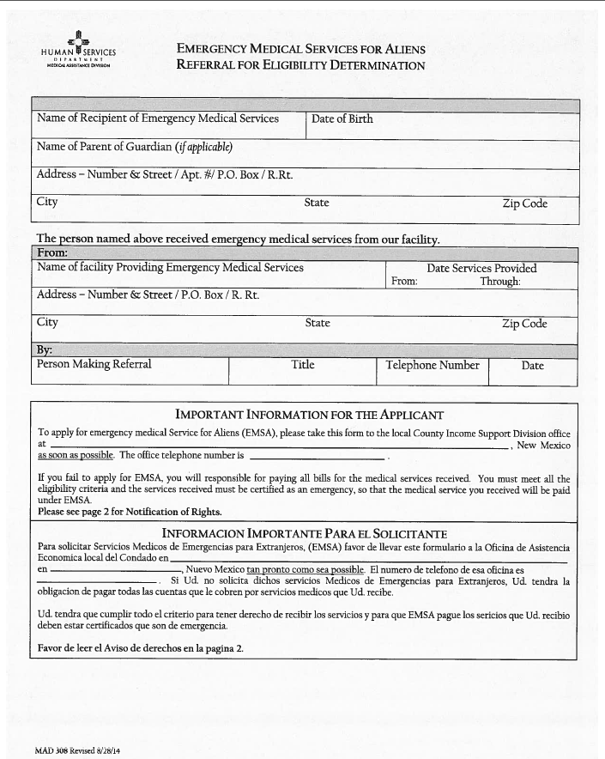
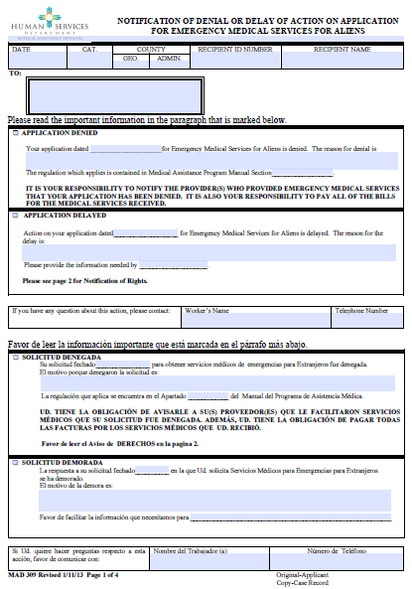
MAD 308 MAD 309

Slide 11
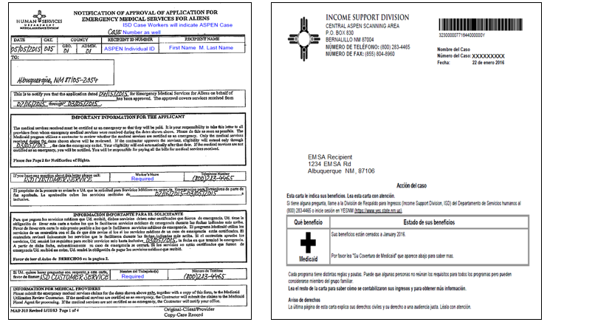
EMSA MAD 310 Notice of Case Action
Notes:
**Speaker Note** Even though the NOCA shows coverage for the entire month, please be aware the coverage is captured for the specific dates they received emergency services.

Slide 12
New EMSA Form Coming Soon
The New Mexico Income Support Division (ISD) will be replacing the current MAD 309, MAD 310 and NOCA with a new form that will be known as the MAD 778. To prevent any delay in billing, the MAD 778 form will be mailed directly to providers in lieu of clients. Launch of the MAD 778 is scheduled for April 29, 2019.
The last day the MAD 310 form will be accepted for EMSA claims, is December 31, 2019.
Effective January 1, 2020, only the new MAD 778 will be accepted for these claim types.

Slide 13
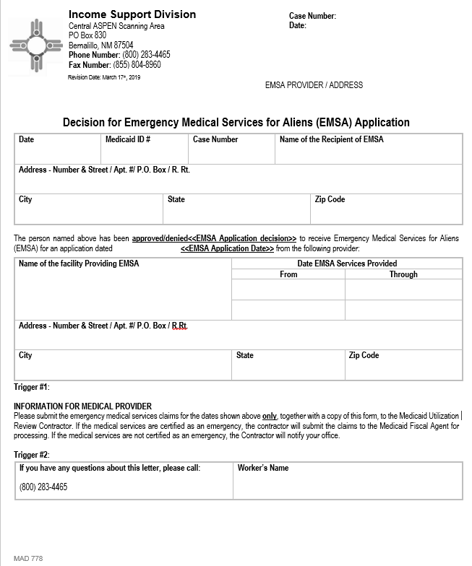
MAD 778
Notes:
**Speaker Note** Even though the NOCA shows coverage for the entire month, please be aware the coverage is captured for the specific dates they received emergency services.

Slide 14
EMSA Labor and Delivery Claims
• A client who is EMSA eligible will have coverage for services related to complications encountered during pregnancy and/or services provided during labor and delivery.
• These claims are processed without medical review by the TPA. The Diagnosis Related Grouper (DRG) assigned in the processing of the claim is what determines whether the claim will be paid.
• The diagnosis code(s) entered on the claim is the information used by the claims processing system to determine the assignment of the DRG. The billing provider is responsible for ensuring that the appropriate diagnosis codes are entered on the claim.
• The only reason this type of claim will post for TPA review is if the diagnosis information results in an unrelated DRG to be assigned.

Slide 15
Newborn Medicaid Coverage and Recertification
Initial Coverage
  After the mother is approved for EMSA and the provider sends ISD the MAD313 (Notification of Birth) the ISD worker may open a COE 031 Newborn Medicaid.
Recertification
  After one year, the child’s eligibility must be re-established pursuant to the requirements for proof of citizenship and identity.
  For continued eligibility after the first year, the parent must submit an application or recertification notice for the child to continue Medicaid eligibility.

Slide 16
Viewing EMSA Eligibility via the NM Medicaid Web Portal
Conduent
Government Healthcare Solutions

Slide 17
EMSA Eligibility on the NM Web Portal
To review a recipient’s Category of Eligibility (COE) 085, providers can visit the New Mexico Medicaid Web Portal at: https://nmmedicaid.portal.conduent.com/static/index.htm.
  If you are unable to access the Web Portal, please contact the HIPAA Helpdesk at HIPAA.Desk.NM@conduent.com.
The following slides show how the eligibility is displayed on the NM Medicaid Web Portal when the client has COE 085.
Even though a Category of Eligibility (COE) 085 displays, providers must obtain a valid MAD 310, NOCA, or MAD 778 form. The MAD 778 form is scheduled to be launched April 29, 2019. Please refer to slide 22 and 23 for claim submission requirements that must be met in order to get your claim processed correctly.
Notes:
Note: You must always ensure you attach the MAD 310 / NOCA to the EMSA billed claims.

Slide 18
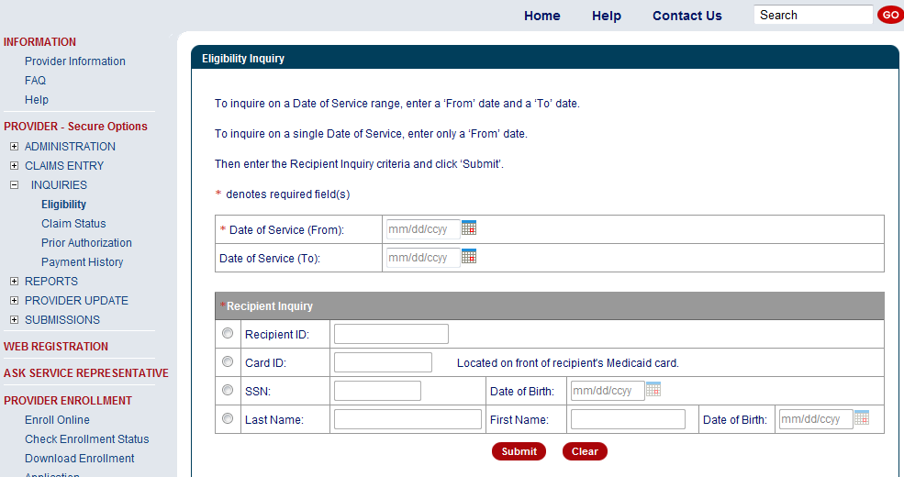
EMSA Eligibility on NM Web Portal
Name and Date Of Birth on MAD 308

Slide 19
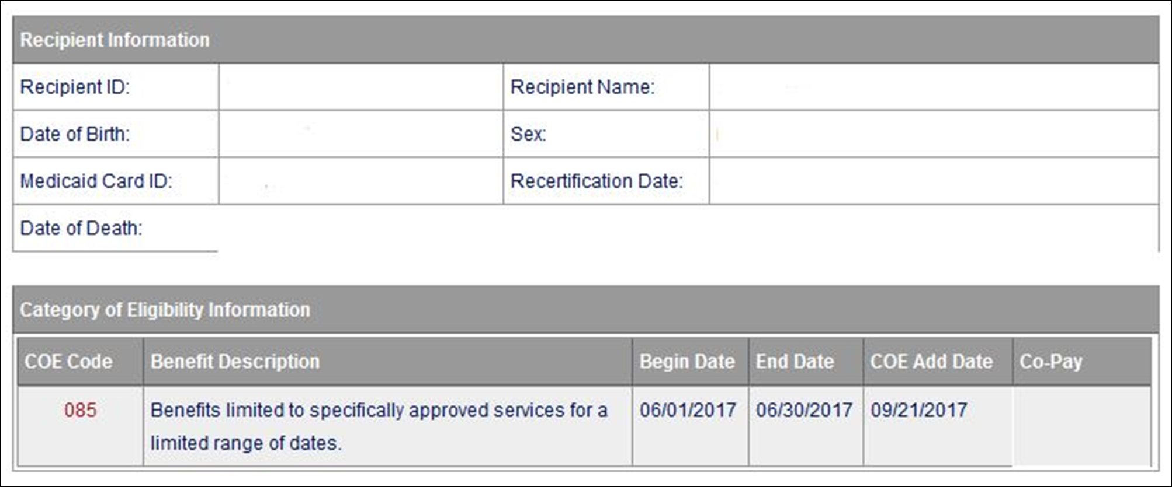
EMSA Eligibility on NM Web Portal Continued
Client ID #

Slide 20
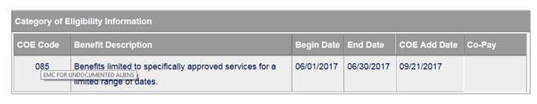
EMSA Eligibility on NM Web Portal Continued
Within the web portal record, hover your mouse directly over the COE Code # to review the COE definition. I.e.. COE 085 is “EMC FOR UNDOCUMENT ALIENS”

Slide 21
EMSA Claim Submissions
Conduent
Government Healthcare Solutions

Slide 22
EMSA Claim Submission Requirements
Paper claims must be original red claim forms; copies will not be accepted and will be returned.
The recipient’s name on the claim and other attachments must match the name on the MAD 310, NOCA, or MAD 778.
  Inpatient Claim Attachments:
    MAD 310 form, NOCA, or MAD 778
      (Dates on MAD 310 form, NOCA, or MAD 778, must match the dates of service on the claim)
    Admit History and Physical
    Emergency Department Records
    Discharge summary
    Any pertinent diagnostic imaging and/or lab results (if not included in H&P or Discharge Summary)
    Operative Notes (ONLY if surgery was done)

Slide 23
EMSA Claim Submission Requirements Continued
  Outpatient Hospital Claim Attachments:
    MAD 310 form, NOCA, or MAD 778
      (Dates on MAD 310 form, NOCA, or MAD 778 must match the dates of service on the claim)
    History and Physical
    Operative Notes (ONLY if surgery was done)
    Emergency Department Records
  Physician, Lab, and Transportation Claims:
    It is not necessary for providers to attach a MAD 310, NOCA, MAD 778, or medical notes to process EMSA claim types Physician, Lab and Transportation.
    These claim types may be submitted electronically or via the NM Portal.
    Physician, Lab, and Transportation claims will be denied if there is not an approved or paid Inpatient or Outpatient claim with matching dates of service.
Please note: Only send pertinent medical records that relate to the Emergency Service provided. Complete Medical Records are not required.

Slide 24
Submitting EMSA Claims
EMSA submissions can be mailed, delivered or uploaded to the New Mexico Web Portal.
All paper claims are to be mailed or delivered to Conduent:
Mail to: Conduent Deliver to: Conduent
Attn: NM Medicaid Claim 1720-A Randolph Rd SE
P.O. Box 26500 Albuquerque, NM 87106
Albuquerque, NM 87125-6500
Click here to submit electronically (file attachment limit of 10MB) via the New Mexico Medicaid Web Portal

Slide 25
EMSA Claim Status Inquiry
Paper Submissions
    Allow 4 weeks from the date claim(s) were submitted to Conduent to appear on the Web Portal.
Online Web Portal Submissions
    TCN will generate after claim has been submitted. Allow 2 - 3 weeks from submission date for EMSA review.

Slide 26
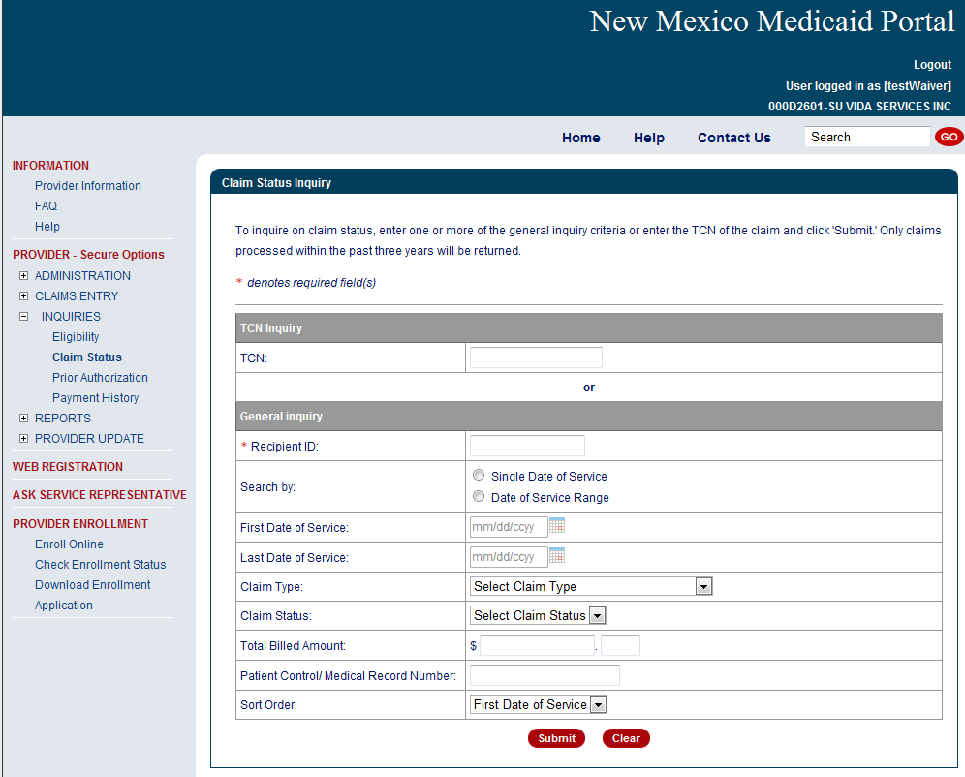
NM Web Portal Claim Status Inquiry
https://nmmedicaid.portal.conduent.com/static/providerlogin.htm
Required information to generate the search – Recipient ID and First Date of Service.

Slide 27
EMSA Determinations

Slide 28
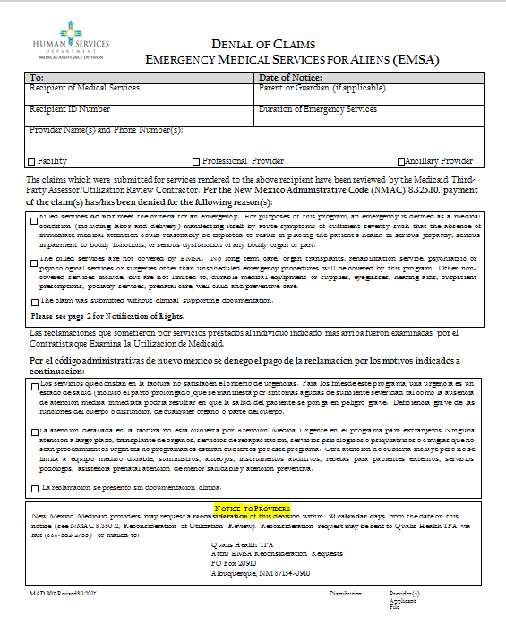
EMSA Claim Denials by TPA
  If EOB denial code 1301 (claim reviewed and denied by the TPA) appears on the provider’s Remittance Advice for the claim, please refer to the letter sent by the TPA/UR contractor regarding denial of the services based on the medical record review. Claims denied by the TPA cannot be resubmitted to Conduent.

Slide 29
EMSA Questions Regarding Medical Reviews or Reconsiderations
For questions regarding EMSA medical reviews please contact the TPA/UR toll-free Customer Service Line at 1-866-962-2180.
Reconsideration of medical reviews may be sent to the TPA via fax (888-562-2755) or mailed to:
          Comagine Health TPA
          Attn: EMSA Reconsideration Requests
          PO Box 20910
          Albuquerque, NM 87154-0910
Providers should include additional documentation when submitting an EMSA reconsideration. If there is no new information provided, the request will be denied.
Reconsiderations of medical reviews may only be requested via fax or mail within 30 calendar days from the date of notice.
EMSA reconsideration of medical reviews submitted to Conduent will be returned to the provider.
Notes:
**SPEAKER NOTE** any claims that have the 1301 exception code that the provider feels should be reconsidered, those must be sent to the TPA instead of Conduent.

Slide 30
EMSA Claim Denials by Conduent - Resubmission
When an EMSA claim is denied before TPA review (not showing EOB code 1301 on the remittance advice and no TPA denial letter has been received), the provider can resubmit a corrected claim. The claim must be on an original red claim form and have all attachments required for the original claim. Enter the TCN of the original denied claim in the appropriate box for proof of timely filing.
Note: If a paid claim needs to be corrected, the claim must be submitted with an adjustment form. Do not submit an adjustment for a denied claim.

Slide 31
EMSA Claim Denials – Explanation of Benefits (EOB) Codes
Current EMSA EOB denial other than 1301, Denial of payment:
EOB Code 0222 – Client name or date of birth does not match file
EOB Code 1303 – Outpatient claim denied for invalid provider type or lacks emergency room rev code
EOB Code 1304 – Claim denied for medical notes required and not attached
EOB Code 1305 – Physician, Lab, or Transportation claim denied for no paid hospital claim overlapping dates of service
EOB Code 1306 – Physician claim denied for invalid place of service code
EOB Code 1307 – The claim denied because the place of service does not justify payment
EOB Code 1308 – Transportation claim denied for invalid place of service or modifier code

Slide 32
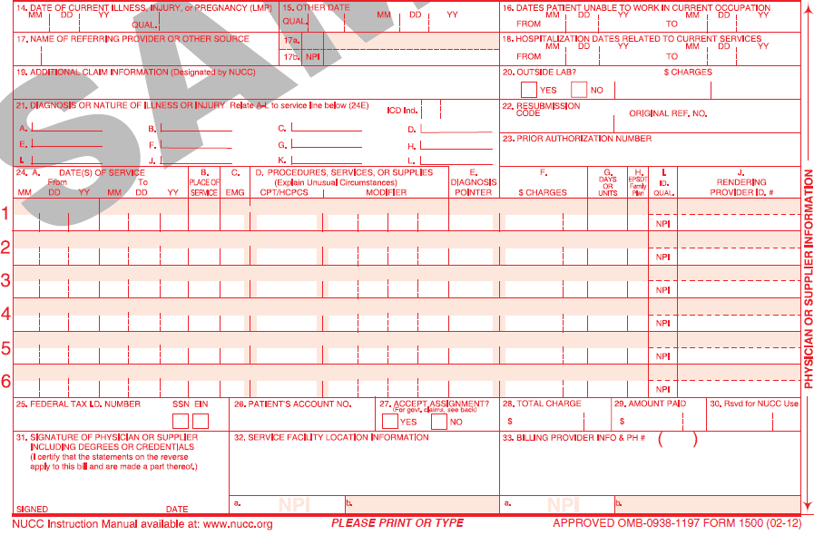
EMSA Claim Denials – Resubmissions to Conduent Continued
CMS 1500 (Physician, Laboratory, and Transportation claims) - Indicate the initial denied TCN within the timely filing period in the “Original Reference No.” box 22. Leave the “Resubmission Code” field blank.

Slide 33
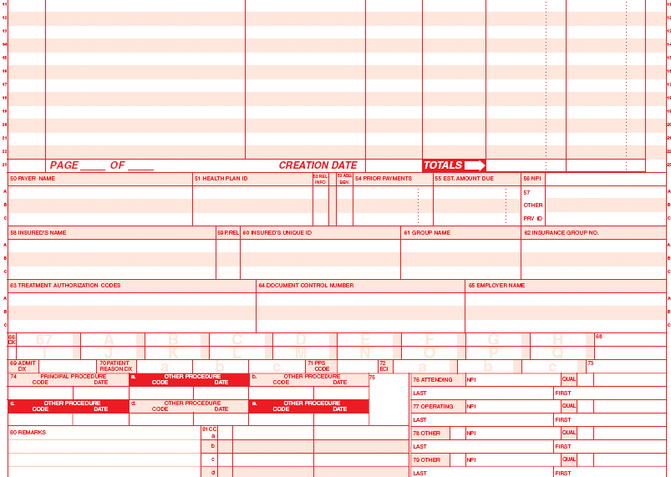
EMSA Claim Denials - Resubmissions to Conduent Continued
UB 04 (Inpatient and Outpatient) - Indicate the initial denied TCN within the timely filing period in box 64 on the form.
0001
1
1
082807
8,100 00
1234567890
MEDICAID
123456789
B3
332S00000X

Slide 34
EMSA Claim Adjustments
An Adjustment request must be submitted to Conduent when a previously paid EMSA claim needs to be corrected.
      Click here to get an Adjustment Request form.
The Adjustment Request form requires:
  The TCN of the paid claim for the adjustment process and proof of timely filing.
  Indicate clearly on the adjustment form the reason for the changes to the claim.
  Attach the corrected CMS or UB claim form. It must be an original red claim form, not a copy.
  Incomplete or unsigned adjustment forms will be returned to the provider.
For all other billing questions regarding denials, please call Conduent Provider Relations Helpdesk at
800- 299-7304 option 6.

Slide 35
EMSA Reconsiderations
Providers may request a reconsideration if the TPA denies a claim due to not meeting EMSA criteria. The provider may submit additional medical records for the TPA for reconsideration within 30 days from the date of the denial notice. The provider must submit the request for reconsideration in writing to the TPA. The request for reconsideration must include the following:
  Reference to the challenged decision or action
  Basis for the challenge
  Copies of any document(s) pertinent to the challenged decision or action
  Copies of claim form(s) if the challenge involves a claim for payment which is denied due to an UR decision
  A statement that reconsideration of the decision is requested
Reconsiderations may be sent to the TPA via fax (888-562-2755) or mailed to:
Comagine Health
TPA Attn: EMSA Reconsideration Requests
PO Box 20910 Albuquerque, NM 87154-0910.
After the reconsideration request has been reviewed by the TPA, the provider will receive notification of the reconsideration decision. The client also has the right to request a reconsideration per NMAC 8.350.2.10.
Please note: If there is no new information provided, the claim will be denied by the TPA.

Slide 36
EMSA Out of State Claims
Only out of state labor and delivery is covered.
  Out-of-state medical services are limited to deliveries only when provided by an out of state border provider. The EMSA client must be a resident of New Mexico. The border provider must be an enrolled Medicaid provider as well.
For all other billing questions regarding reconsiderations and out of state claims, please call Conduent Provider
Relations Helpdesk at 800- 299-7304 option 6.

Slide 37
EMSA Frequently Asked Questions (FAQs)
Conduent
Government Healthcare Solutions

Slide 38
EMSA Claim FAQs
Can a paid EMSA claim be adjusted?
    Yes. An Adjustment Request form must be completed and attached to the corrected claim. Please include a clear explanation of why the adjustment is being requested.
Can a denied EMSA claim be resubmitted?
    If the EOB code on the Remittance Advice is 1301 and you received a denial letter from the TPA, reference the medical review reconsideration process outlined in the letter. Medical review reconsiderations must be submitted to the TPA. Conduent does not process or review medical review reconsiderations.
    If the EOB code on the Remittance Advice is 1301 but you did not receive a denial letter from the TPA, contact Provider Relations at (800) 299-7304 option 6 for further assistance.
    If the EOB code is anything other than 1301, resubmit a corrected claim to Conduent with required attachments and original TCN for proof of timely filing. If the EOB code is not clearly understood, contact Provider Relations at (800) 299-7304 option 6 for further assistance.
    Note: Conduent claim reconsideration forms should not be submitted to the TPA.

Slide 39
EMSA Claim FAQs Continued
What are the timely filing requirements for EMSA claims?
    The claim must be received within 90 days from the date of service or 120 days from the recipient’s eligibility approval date.
    For a denied claim which met the initial timely filing period, there is a 90 day grace period counted from the date of denial.
    A paid claim can be adjusted within 90 days of the payment date.
    Can the provider bill the client?
    If the individual fails to inform the medical provider of their approval for EMSA services and the resulting claim is denied for timely filing, the
    provider may bill the client.
    For instructions and policy information, please visit: http://www.hsd.state.nm.us/uploads/files/Providers/New%20Mexico%20Administrative%20Code%20Program%20Rules%20and%20Billing/NMAC%20Program%20Rules/Chapter%20302/8_302_2(3).pdf
    The client and/or provider may also review the disclosure notices on the MAD 308/309/778 forms for more information.

Slide 40
EMSA Claim Reminders, Tips, and Resources
Conduent
Government Healthcare Solutions

Slide 41
EMSA Claim Reminders & Tips
Verify information on claim matches the MAD 310 / NOCA/ or MAD 778
  Client First and Last Name
  Recipient ID Number
  Dates of Service
Include your billing NPI with taxonomy code when applicable
Verify that revenue, procedure, and diagnosis codes are correct
For Outpatient hospital claims, an emergency room revenue code (450-459) is required
Enter attending, operating, referring, rendering, or ordering provider NPIs when required
Continued on next page . . .

Slide 42
EMSA Claim Reminders & Tips Continued
Ensure the line item charges are correct and match the total charge
Include initial TCN for proof of timely filing if applicable
Always include MAD 310 / NOCA / MAD 778 for Inpatient and Outpatient claims
Ensure all pertinent medical records that relate to the emergency services are attached to the claim; the entire medical record is not required
Ensure all appropriate EOB’s (TPL, HMO, etc.) are attached to the claim
Keep a copy of the correspondence for your records

Slide 43
New Mexico Medicaid Resources Continued
New Mexico Medicaid Portal – https://nmmedicaid.portal.conduent.com/static/index.htm
Claim Inquiries, Eligibility Verification, Electronic Claim Submission, Provider Manuals, E-News
NM Human Services Department – http://www.hsd.state.nm.us/mad/
Supplements, Memos, Provider Billing Packets and Policy
Conduent Provider Relations Call Center – (800) 299 - 7304 option 6 or (505) 246 - 0710 option 6.
Claim Status, Eligibility, Prior Authorization, Medicaid Updates
Conduent Provider Relations Helpdesk – NMProviderSUPPORT@conduent.com
Claim research assistance and general Medicaid inquiries
Conduent HIPAA Helpdesk – HIPAA.Desk.NM@conduent.com
Assistance on NM Web Portal, EDI inquiries, and Online Claim Submission with DDE (Direct Data Entry)
Conduent Provider Enrollment Helpdesk - NMProviderSUPPORT@conduent.com
Provider Enrollment Applications, Forms & Instructions
NM Medicaid Recipient Helpdesk – (888) 997 – 2583 or (505) 247 – 1042
Eligibility inquiries, Fee-for-Service Replacement Medicaid Identification Card, Enroll or change a Managed Care Organization and Eligibility application status
Medical Assistance Division, Program Rules – http://www.hsd.state.nm.us/providers/rules-nm-administrative-code-.aspx
NMAC for Programs administered by the Medical Assistance Division
Yes New Mexico - https://www.yes.state.nm.us/yesnm/home/index
Apply, check, update, or renew Medical Assistance (Medicaid) benefits

Slide 44
Fee for Service Claim Requirements for Rendering, Referring, Ordering, and Attending Providers
Hospitals, Outpatient Hospitals, Home Health Agencies, Hospices, Nursing Facilities, ICF/IIDs, and Residential Providers (ARTCs, RTCs, and Group Homes): See Supplement 17-07 at: http://www.hsd.state.nm.us/uploads/files/Providers/New%20Mexico%20Administrative%20Code%20Program%20Rules%20and%20Billing/Supplements%20for%20MAD%20NMAC%20Program%20Rules/Supplement%2017-07%20(3).pdf
Clinical Labs, Diagnostics Labs, Radiology Facilities and Radiation Treatment Centers; Providers of hearing aids and supplies , glasses, IV infusions, medical supplies and medical equipment; Occupational Therapists, Physical Therapists, Speech and Language Therapists and Pathologists, and Rehabilitation Centers: See Supplement 17-08 at: http://www.hsd.state.nm.us/uploads/files/Providers/New%20Mexico%20Administrative%20Code%20Program%20Rules%20and%20Billing/Supplements%20for%20MAD%20NMAC%20Program%20Rules/Supplement%2017-08.pdf
All other providers and practitioners of professional services: See Supplement 17-09 at: http://www.hsd.state.nm.us/uploads/files/Providers/New%20Mexico%20Administrative%20Code%20Program%20Rules%20and%20Billing/Supplements%20for%20MAD%20NMAC%20Program%20Rules/Supplement%2017-09.pdf

Slide 45
EMSA Medical Assistance Division Program Policy Rules
  EMSA Program Rule; Chapter 325 - NMAC 8.325.10
  EMSA Eligibility Recipient Rules; NMAC 8.285.400, 8.285.500, & 8.285.600

